Slide 1
Hadoop Ecosystem

Slide 2
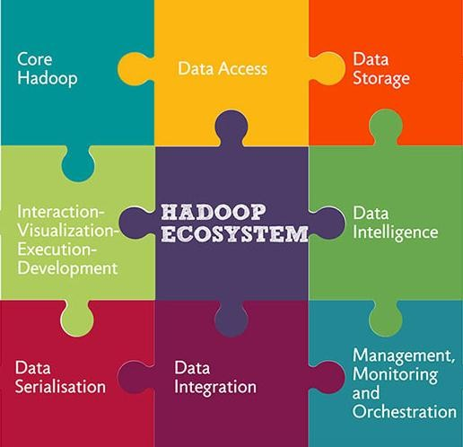
Hadoop Ecosystem

Slide 3
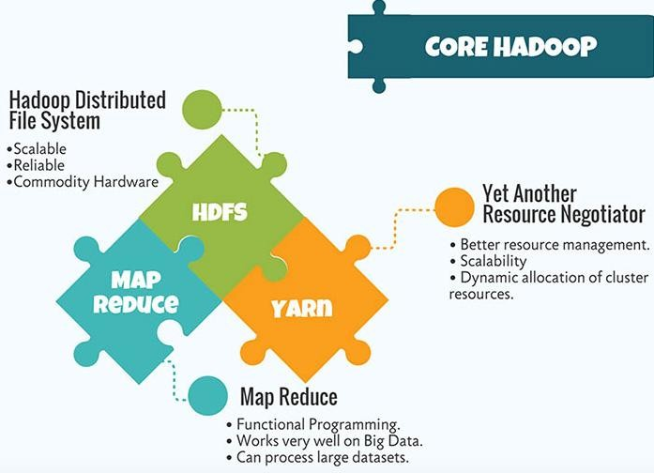

Slide 4
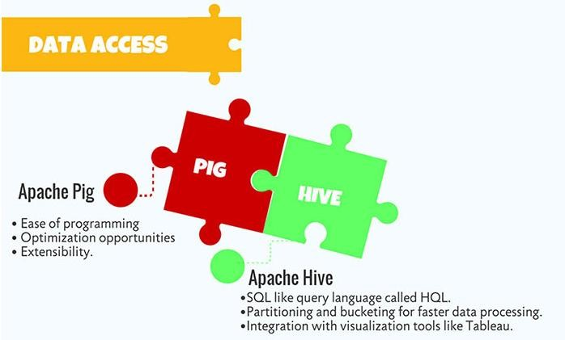

Slide 5
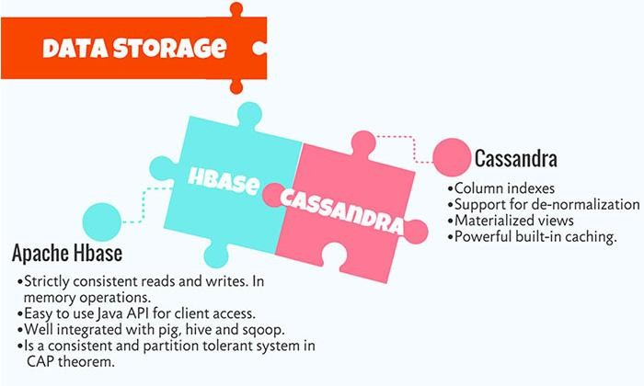

Slide 6
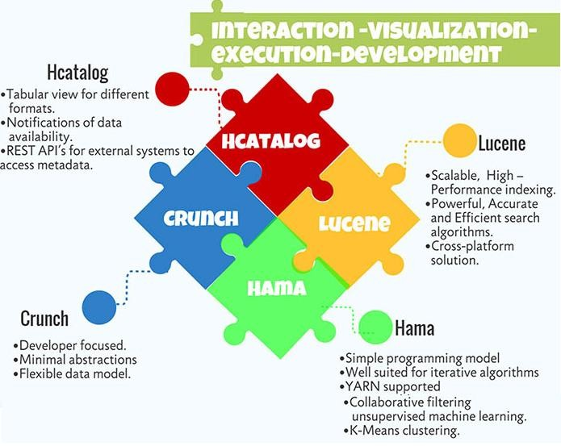

Slide 7
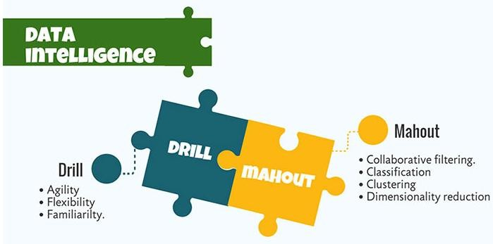

Slide 8
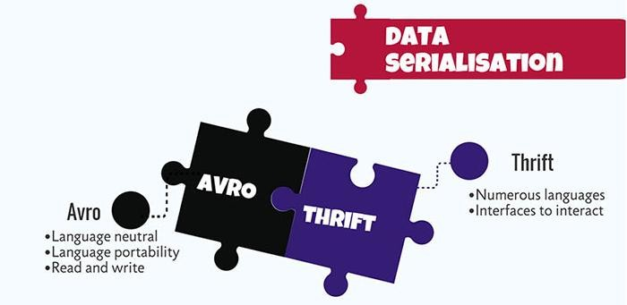

Slide 9
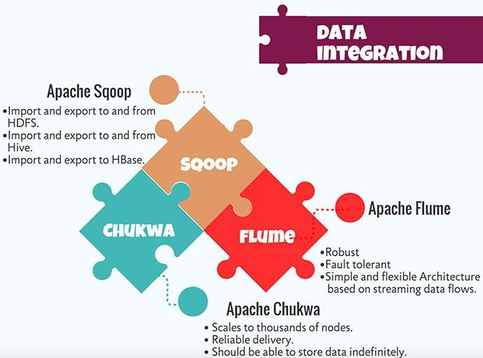

Slide 10
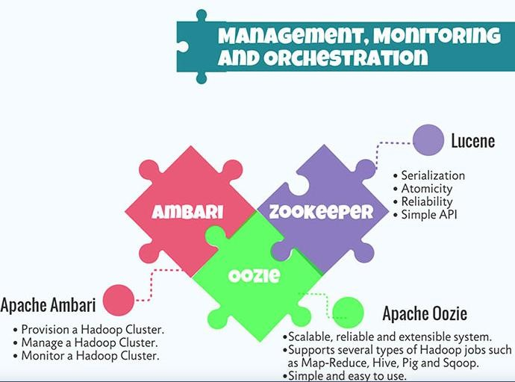

Slide 11

Hadoop Ecosystem

Slide 12
Hadoop Ecosystem

Slide 13
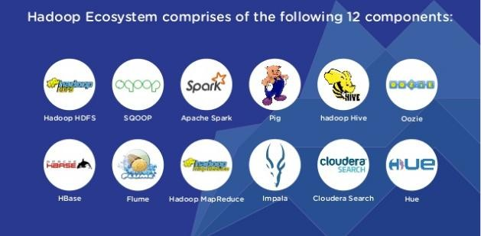

Slide 14
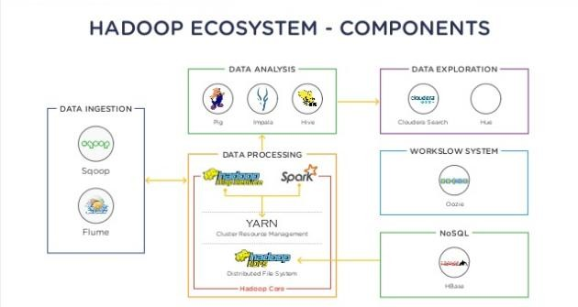

Slide 15
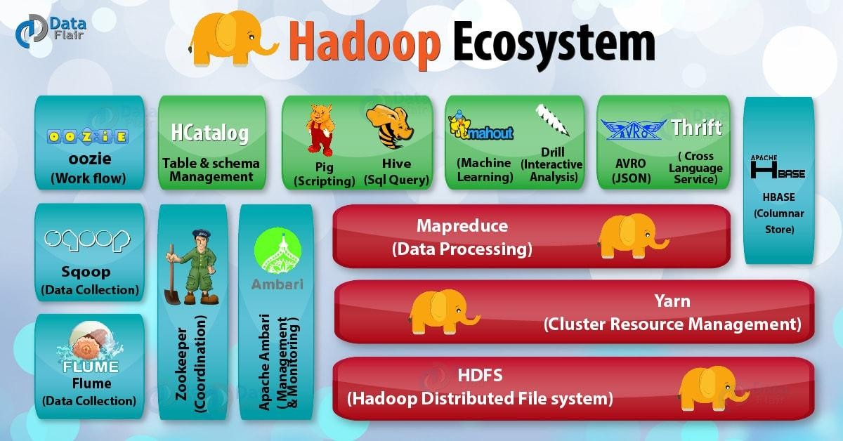
Hadoop Ecosystem

Slide 16
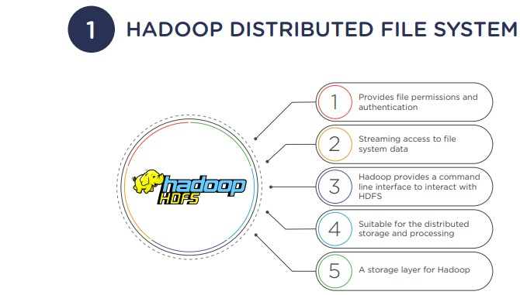

Slide 17
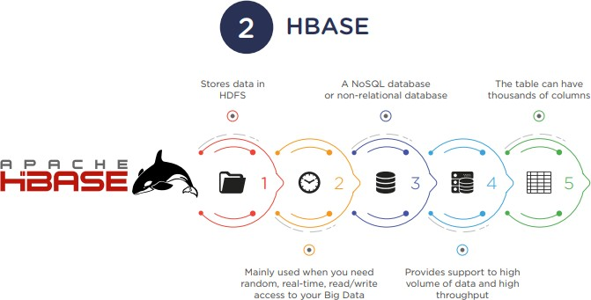

Slide 18
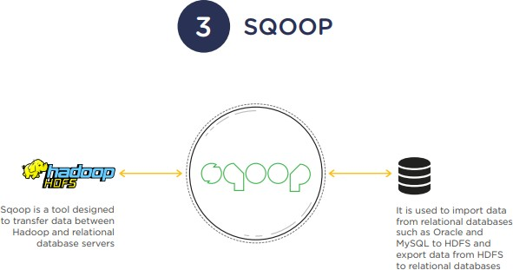

Slide 19
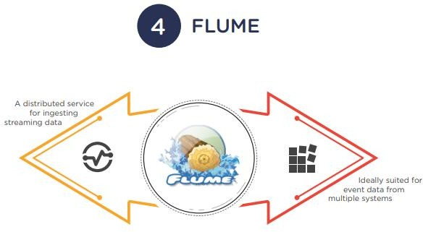

Slide 20
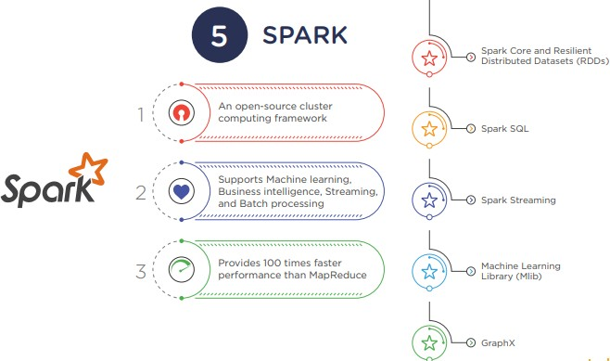

Slide 21
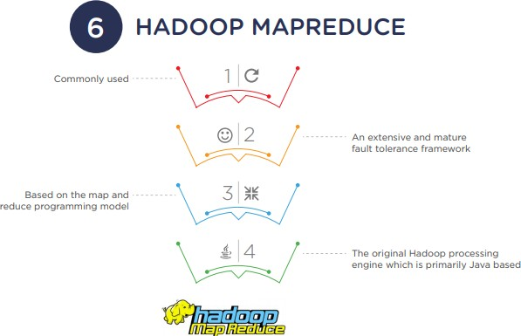

Slide 22
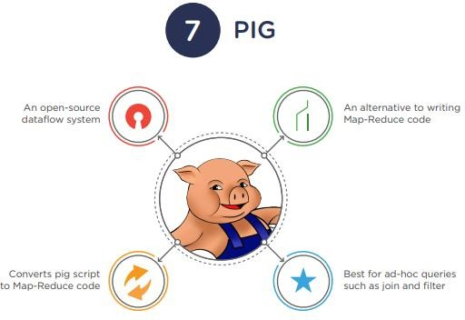

Slide 23
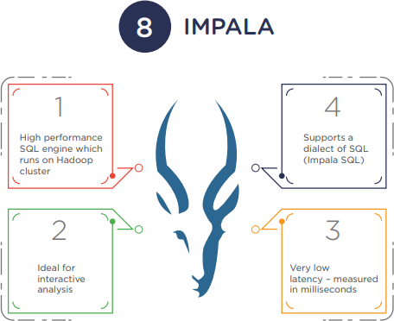

Slide 24
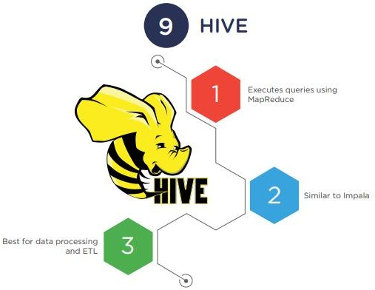

Slide 25
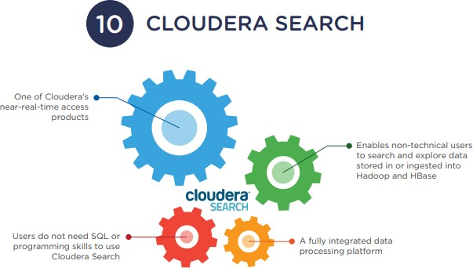

Slide 26
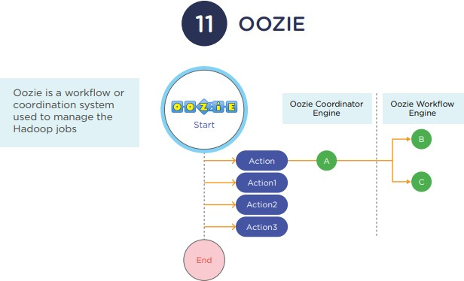

Slide 27
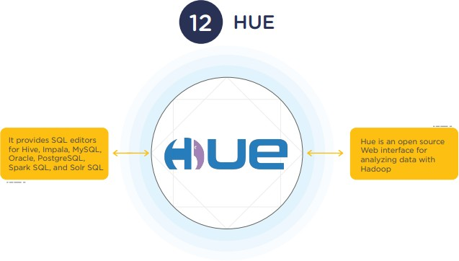

Slide 28
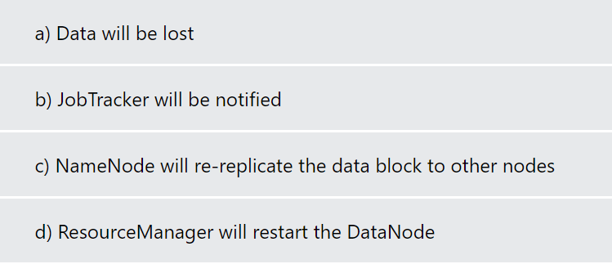
Quiz Time
In a Hadoop cluster, if a DataNode fails

Slide 29
Quiz Time
In a Hadoop cluster, if a DataNode fails
Answer:
c) NameNode will re-replicate the data block to other nodes

Slide 30
Hadoop Ecosystem: Pig (1|4)
Pig is a data flow system for Hadoop.
It uses Pig Latin to specify data flow.
Pig is an alternative to MapReduce Programming.
It abstracts some details and allows you to focus on data processing.
It consists components.
Pig Latin: The data processing language.
Compiler: To translate Pig Latin to MapReduce Programming.

Slide 31


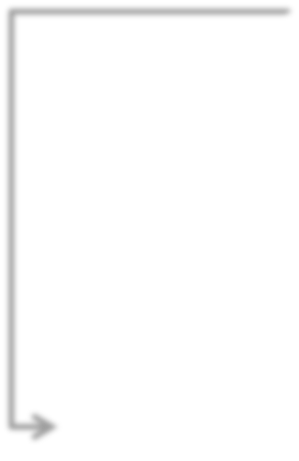
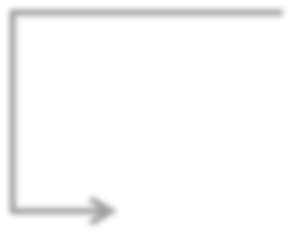






Pig in the Hadoop ecosystem.
Pig(Scripting)
MapReduce (Distributed Programming Framework)
HDFS (Hadoop Distributed File System)

Slide 32
Hadoop Ecosystem: Hive (2|4)
Hive is a Data Warehousing Layer on top of Hadoop.
Analysis and queries can be done using an SQL-like language.
Hive can be used to do ad-hoc queries, summarization, and data analysis.

Slide 33

Hive in the Hadoop ecosystem.
Hive (SQL like Queries)
MapReduce (Distributed Programming Framework)
HDFS (Hadoop Distributed File System)

Slide 34
Hadoop Ecosystem: Sqoop (3|4)
Sqoop is a tool which helps to transfer data between Hadoop and Relational Databases.
With the help of Sqoop, you can import data from RDBMS to HDFS and vice-versa.

Slide 35

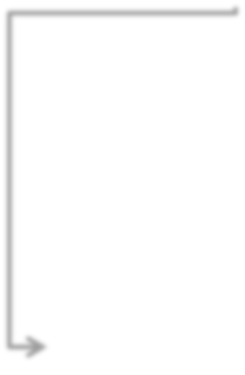




SQOOP in the Hadoop ecosystem.
SQOOP (Import and Export Tool)
MapReduce (Distributed Programming Framework)
HBase
Hive HDFS

Slide 36
Hadoop Ecosystem: Hbase (4|4)
HBase is a NoSQL database for Hadoop.
HBase is column-oriented NoSQL database.
Hbase is used to store billions of rows and millions of columns.
HBase provides random read/write operation.
It also supports record level updates which is not possible using HDFS.
HBase sits on top of HDFS.

Slide 37








Hbase in the Hadoop ecosystem.
MapReduce (Distributed Programming Framework)
Hbase (NoSQL database)
HDFS (Hadoop Distributed File System)

Slide 38
Match the columns
Column A Column B
HDFS
MapReduce Programming
Master node
Slave node
and MapReduce
Hadoop Implementation
DataNode NameNode
Processing Data Google File System
Storage

Slide 39
Match the columns
Column A Column B
JobTracker
MapReduce
TaskTracker
Job Configuration Value pair
Map
Executes Task Schedules Task Programming Model Converts input into Key
Job Parameters
•

Slide 40
Answer a few quick questions …
Match the following
Column A | Column B
NLP | Content analytics
Text analytics | Text messages
UIMA | Chats
Noisy unstructured data | Text mining
Data mining | Comprehend human or natural language input
Noisy unstructured data | Uses methods at the intersection of statistics, Artificial Intelligence, machine learning & DBs
IBM | UIMA

